Slide 1

VINDHYA INSTITUTE of TECHNOLOGY & SCIENCE
SATNA
(E-COMMERCE WEBSITE)
OUR HOUSEKEEPER
Under the Guidance of:-
CP GAUTAM SIR
Asst. prof. (CSE)
Presented By:-
PAWAN CHATURVEDI
Enrol No. 0302CS181024
Mr. Pradeep Tripathi
HOD (CSE)
VITS, Satna

Slide 2
Contents
Abstract
Introduction
Objective
Literature Survey
Problem statement
Proposed work
Proposed algorithm
Proposed Architecture
Results and Analysis
Conclusions
Scope of Future Work
References
publication

Slide 3
ABSTRACT
Traditionally ,the digital home services have been provided separately by each service provider that have closed service delivery infrastructure for delivering home services.
Because of these small companies which have less infrastructure to deploy home services have difficulties in participating in the home network market.
To solve this problem we propose the new digital our housekeeper service system that provide open service platform to provide all kind of service and help this digital market grow rapidly…

Slide 4
INTRODUCTION
The key of housekeeper project is in integrating existing and adding new features to the global e-commerce network by providing the easiest solution for multiple home work.
We should identify customers need because before you start your on demand app development ,it is compulsory to understand your target audience and their needs. You can do this by conducting market research and surveys to understand what exact kind of services they are looking for…

Slide 5
OBJECTIVE
Provide very cheapest home service to our city people .
The person who want to provide service they can join this business and provide their service easily .
All the payment are done by net banking only and the service provider is not involve in payment they only done work and fill the detail of all work…

Slide 6
LITERATURE SURVEY
A survey on growth and success of home service website in India::
By International Journal of Soft Computing and Engineering(IJSCE)
ISSN:2231-2307,volume-1,issue-5,November 2011
for the purpose of analysis the author conducted a survey among the respondents. The survey asked respondents to list the most important resource organization would need to further develop when pursuing
Home business initiatives. The most popular response was the human component of the organization .the two most cited issues that respondents claimed were holding back e commerce development related to government were security and legal infrastructure..
“BUILD-IT-AND-IT-WILL-COME” logic work for a small no. of small and medium enterprises.

Slide 7
PROBLEM STATEMENT
THERE ARE MANY KIND OF PROBLEM OCCURS—
Sub system not integrating
Insufficient features and functionality
Too many home automation control apps
Lenghty delays during the construction of your project
Sub system suppliers lacking smart knowledge

Slide 8
PROPOSED WORK
Lawn care and landscaping services proposal
Network cabling services sample proposal
Painting constructor sample proposal
Plumber services sample proposal
Electrical constructor working proposal…

Slide 9
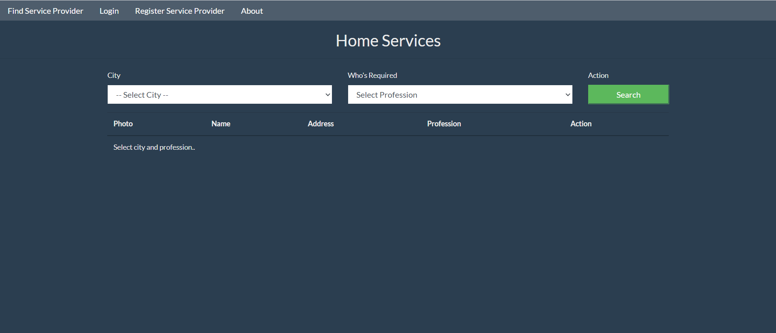
Proposed algorithm
Start with xampp server :- enter home page
Here we have navigation bar in which you see the service providers—
Step 1:- choose city
Step 2:- choose providers
Step 3:- then search the service providers
If service providers available then show other wise ‘no service provider available ’show in display..

Slide 10
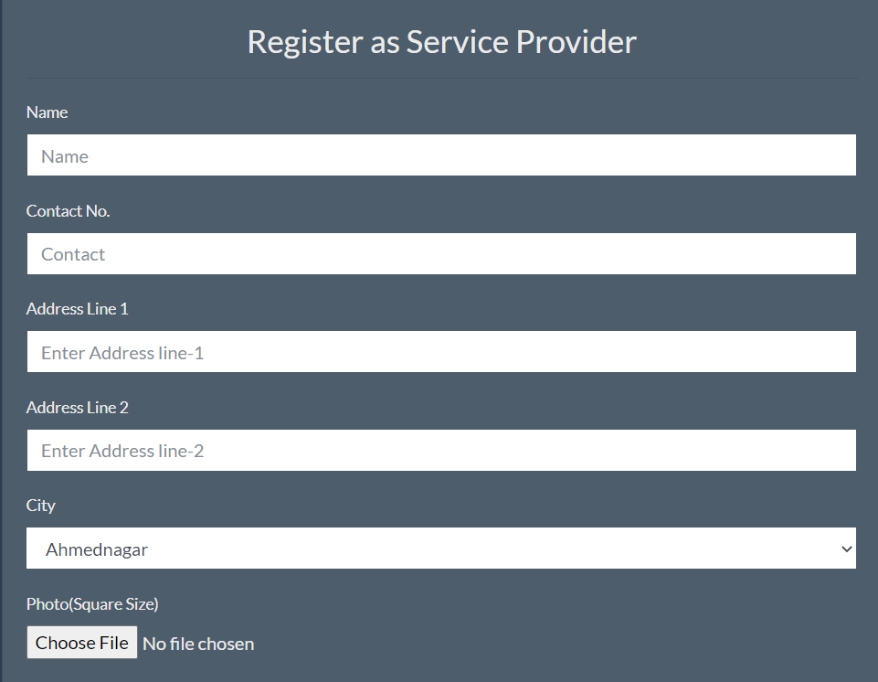
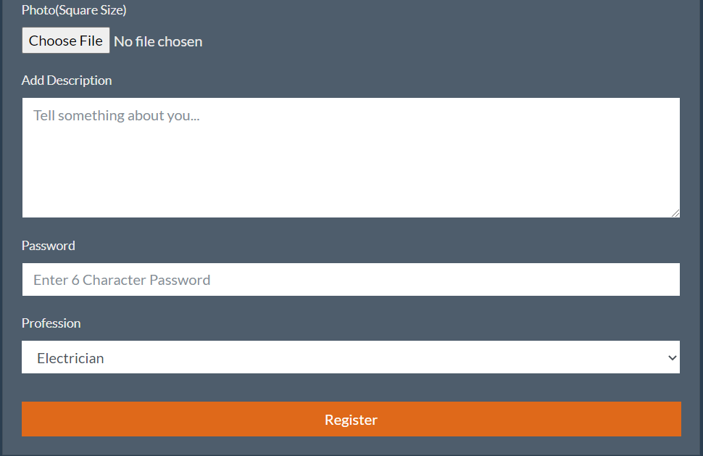
If you want to provide service then—
Step1:- register as service provider
Step2:- fill all the information given below

Slide 11
Proposed architecture
Fill name
Con. No.
Add.
Photo
Password
registered
login
Find services
Provide services
Choose city
Choose service
Search
Book
get service
If there is no service provider then
Logout
No service provider available

Slide 12
RESULT AND ANALYSIS
The market for home service in India - a cheaper and more comfortable service for people---is set to double in in year of time…
With advancements in information technology and integration, it is now possible to provide high quality service at home at affordable price.
The industry is witnessing a rising demand from the real state sector in managing service like security, electrical, cleaning and all kind of home services .

Slide 13
CONCLUSION
Build smart India and Raise awareness about e business…
Get more leads to provide best service..
Make more service providers…
Make the world smart…
In general today’s businesses must always strive to create the nest best thing that consumers will want because consumers continue to desire their product service etc…

Slide 14
SCOPE OF FUTURE WORK
E commerce , which emerged in early 90’s stands for purchasing, selling, and exchanging goods and services using internet enabled electronic devices .
India is expecting a significant huge market for this kind of digital home service which key factors are
Manageable quantities
Personalized services
Innovative schemes
Reduction in the cost of broadband internet facilities

Slide 15
REFERENCES
E commerce has shifted from being an optional side channel to being a crucial business block for any successful business …
it take a lot of reference::--
www.google.com
www.digisoftinfotech.com
www.webfx.com
www.enterpreneur.com
International Journal of Soft Computing and Engineering(IJSCE)
Author:- Mohammed Ali Hussain
R.Satya Prasad

Slide 16
THANK YOU

